Slide 1
Best Practices
Loke KS

Slide 2
Reference
Gavin Zheng, Longxiang Gao, Liqun Huang, Jian Guan. Ethereum Smart Contract Development in Solidity, Springer Nature Singapore. 2021. ISBN 978-981-15-6218-1

Slide 3
Developing Secure Contract
Smart contract deployed on Ethereum is publicly accessible and transparent.
Developing smart contract needs a completely new thinking vector which is different from prior projects development.
Smart contract usually manages a huge amount of fund. Due to its inherent feature of transparency and public accessibility, fixing the bug of smart contract is not as easy as traditional software patching
The consequence of vulnerability of smart contract could be disastrous.

Slide 4
Attacking Vector
Attacking vectors are classified as below:
Oveflow/underflow
Delegatecall
Loops
timestamp, random,
Reentrancy
Denial of Service (DoS)

Slide 5
Overflow/Underflow
When an operation needs to use a fixed-size variable to save a digital number, if the number is outside the range of variable type, it will lead to overflow/underflow
The typical technique to guard against under/overflow vulnerabilities is to use or build mathematical libraries which replace the solidity standard math operators; addition, subtraction, and multiplication
division is excluded as it does not cause over/under flows and the EVM throws on division by 0

Slide 6
Overflow/Underflow
OpenZepplin provides a well-known and widely accepted implementation of Safe Math
For Solidity 0.8, SafeMath is not needed (but you would need it in older versions), and you can replace the functions with standard arithmetic operations.

Slide 7


Overflow/Underflow
If unsigned integer is used, then 0 minus 1 will get the largest integer in solidity. And this is called underflow
2²⁵⁶–1 (which is a big integer) plus 1 will be 0. This is called overflow.

Slide 8
Overflow/Underflow
For example, assume that a user has no balance; the user could call the transfer() function with any non-zero _value and pass the require statement.
The reason is: balances[msg.sender] is zero, and subtracting any positive amount (excluding 2²⁵⁶) will result in a positive number due to the underflow described above.
Thus, in this example, the user has obtained free tokens caused by an underflow vulnerability.

Slide 9
Delegatecall
Using Delegate Call to call another (callee) contract code will make the callee contract running in the context of caller contract.
That means callee contract code can work on storage, balance, and current address of caller contract.
In the following example, attacker gets the control of caller contract (Delegation) through delegating call to public pwn() function of Delegate under the context of caller contract.

Slide 10
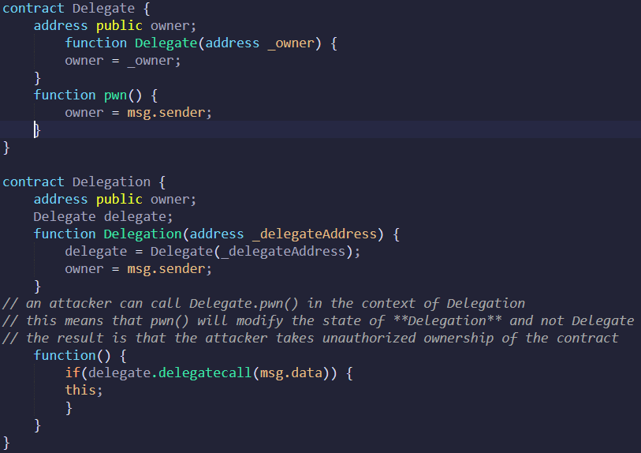
Attacker sends call––Delegation.PWN()
Code execution falls into the fallback function of Delegation since there is no PWN function in Delegation contract
In fallback function, delegatecall sends call to Delegate contract
Attacker manipulates msg.data which contains the function signature to be called. In this case, assume that attacker stuff pwn’s signature into msg.data msg.data ¼ first 8 bytes of sha3 (alias for keccak256)
PWN function in Delegate is called and owner of Delegation will be changed since PWN works in the context of Delegation

Slide 11
Floating Points and Precision
Fixed point numbers are not fully supported by Solidity yet. They can be declared, but cannot be assigned to or from.
we must use integers to present float numbers, which may lead to vulnerability if the contract is not implemented correctly
The general principle is always to keep the right precision in your smart contracts, especially when dealing with ratios and rates

Slide 12
Tx.Origin Authentication
Solidity has a global variable––tx.origin which trace calling stack back to initiator’s address.
tx.origin should not be used for authorization in smart contracts.

Slide 13
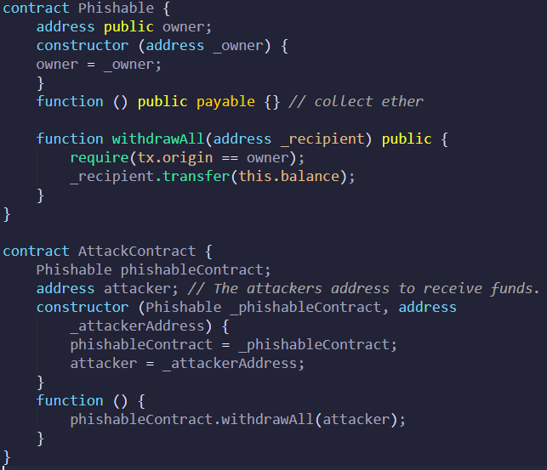
Victim sends a transaction (with enough gas) to the AttackContract address.
Fallback function is invoked.
Calls the withdrawAll() function of the Phishable contract, with the parameter attacker.
This will result in the withdrawal of all funds from the Phishablecontract to the attacker address.
This is because the address that first initializes the call is the victim (i.e. the owner of the Phishable contract).
Therefore, tx.origin will be equal to the owner and the require statement of the Phishable contract will pass

Slide 14
Unchecked CALL Return Values
The call() and send() functions return a Boolean indicating if the call succeeds or fails.
This will lead to a simple caveat: if the external call fails, solidity only returns a flag and will not rollback.
The developer will need to revert manually in such situations.
Whenever possible, using the transfer() function rather than send() as transfer() will revert if the external transaction reverts. If send() is required, always ensure to check the return value.
Better yet - adopt a withdrawal pattern.

Slide 15
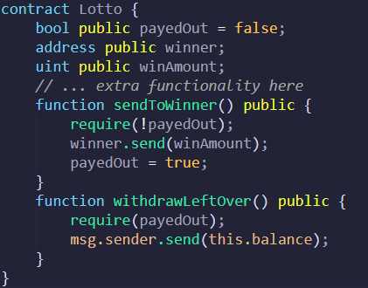
Unchecked CALL Return Values
If winner transaction fails (possibly caused by out of GAS, or call stack depth attack), payedOut will be set to true (regardless of whether ether was sent or not).
In this case, the public can withdraw the winner’s winnings via the withdrawLeftOver() function.

Slide 16
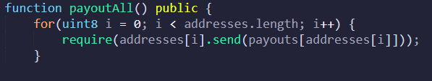
Loops
The for loop uses a uint with size 8 to store the index. Since uint8 can only store a very short range of integers, if the array length exceeds 255, an overflow can occur.
Since the array length is infinite, this issue can arise when the number of addresses in the array is more.
This can also result in permanent DoS for the payout functionality.

Slide 17
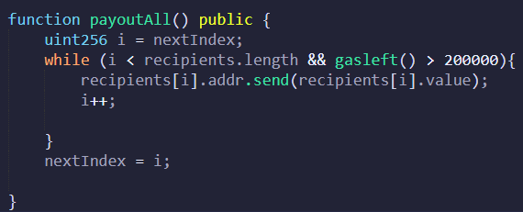
Loops
Using a different data type can solve the underflow issue, but it will still fail to satisfy the block's gas limit. It will take a lot of gas if there are more instructions to execute.
It is recommended to perform a large set of instructions in batches to avoid such issues.

Slide 18
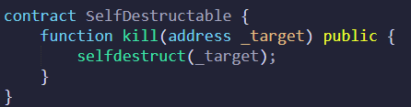
Forcing Ether to A Contract
A require statement may fail if the contract has an unexpected Eth amount sent to it, forcing the contract not to execute.
Eth can be sent to a contract with a self-destruct function even if the contract does not have a fallback payable function.

Slide 19
Forcing Ether to A Contract – selfdestruct
The self-destruct function is generally used for removing the data of a contract from the blockchain.
It also sends the Ether stored in the self-destructing contract to an address specified in the function
Selfdestruct do not require the fallback function. This essentially allows anyone to send Ether to a contract that has no payable fallback function.

Slide 20
Forcing Ether to A Contract – Guess Address
The second way of forcing Ether to a contract involves deterministically finding a contract address.
You can guess a contract address from the RLP encoding of the sender's address.
To generate the contract address, take the rightmost 160 bits of the keccak256 hash of an RLP encoding of the sender’s address and its nonce:
// rightmost 160 bits of
sha3(rlp.encode([sender_address, nonce]))
Using this, a contract developer or someone who has access to this information can easily guess the address and send some Ether to it. This will make any logic that depends on the contract balance useless.

Slide 21
Randomness
Since everything in Ethereum is deterministic, that is to say that there is not a random source in the whole blockchain
A common misuse is to use future block variables, such as hashes, timestamps, block number, or gas limit. The issue with these is that they are controlled by the miner who mines the block and as such are not truly random.

Slide 22
Block timestamp
Block timestamp is used by many apps in implementing their business logic, such as randomness source, and lock period of the fund.
Since the miner is able to adjust block timestamp, improper use of block timestamp will endanger contracts on Ethereum platform
Block timestamps should not be used for entropy or generating random numbers—i.e. they should not be the deciding factor (either directly or through some derivation) for winning a game or changing an important state (if assumed to be random).

Slide 23
Use Pull instead of Push
Every time when we transfer ether, we need to take involving contract and potential code execution into account: A receiver contract may or may not implement a fallback function; fallback function may throw an exception.
So we always need to handle the situation that sends may fail. A solution to this problem is to use pull instead of push.

Slide 24
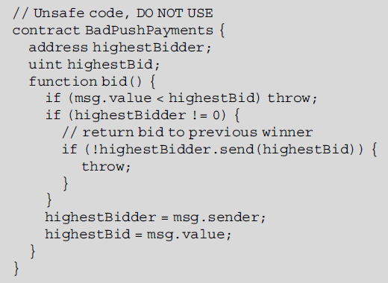
Use Pull instead of Push
Contract above uses send function and checks its return value, which appears reasonable.
The send function might trigger code in other contracts.
For example, some bidder address might throw whenever it receives some ether.
Since send will always fail and exceptions will be bubbled up, state will remain un-changed as before calling send function

Slide 25
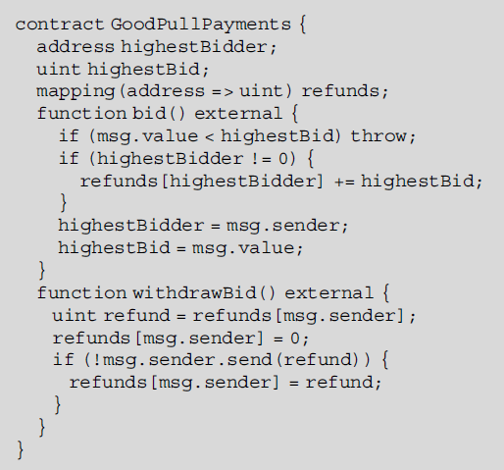
Use Pull instead of Push
The contract uses a mapping variable to store the information of all bidders and provides a withdraw function for refund.
If one sends fails, it does not influence the other send functions.
It is a simple pattern but useful

Slide 26
Reentrancy Problem
Whenever Eth transfer with low level call is invoked, it provides an opportunity for control to flow to a corrupted contract, because the target address could be a contract.
If the address is a contract, when called, the called contract’s fallback function can contain code to call back the calling contract’s function in a recursive manner that can be detrimental.
Use the <address>.transfer function to transfer funds to the account. This has a gas limit of 2,300, which is not enough for actual execution inside a contract

Slide 27
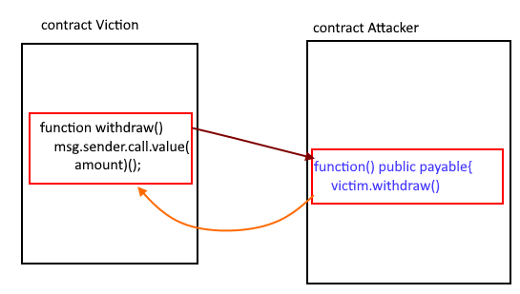
Reentrancy Problem

Slide 28
Preventing Reentrancy
The first and foremost recommendation is not to use the low-level call function to transfer any amount. Use the <address>.transfer function to transfer funds to the account. This has a gas limit of 2,300, which is not enough for actual execution inside a contract.
If you wish to keep the low-level call for some reason, then you could follow the checks-effects-interaction pattern to avoid this issue.
This pattern asks you to make an external call only after all state modifications and conditions are completed. If there are any problems it would revert before the transfer.

Slide 29
Best Practices
Security is the distance from the implementation to what the code is expected to do. Security is very hard to prove, especially when the code set is huge and complex.
And this means:
Function should small
File should be small
Code inter-dependency should be as less as possible
Put independent logic into a separate module
Each module should implement just one logic
Use explicit and easy-to-understand name convention
Do Not Start Coding from Scratch
Have code audit by external parties before live deployment.

Slide 30
Re-entrancy Attack: Example
Objective withdraw ether from Victim contract to Attacker contract and to attacker EOA via selfdestruct
Attacker contract constructor gets Victim contract address
Start by calling the attacker collect() function. It puts some ether into the Victim contract using put() then call the Victim contract get() to the Attacker contract.
The Attacker contract fallback function is invoked which in turn call the Victim contract get() again

